Slide 1


FSLAKWS – Few Shot Language Agnostic Key Word Spotting System
Mini-project review
Presented by, Vaisnava S – 922524148116
BACHELOR OF ENGINEERING in COMPUTER SCIENCE AND ENGINEERING
(ARTIFICIAL INTELLIGENCE AND MACHINE LEARNING)

Slide 2
Objectives
To build a system that learns a keyword from just 5 audio samples given by the user.
To make the system work for any language like Tamil, Hindi, English, Telugu etc.
To search and find every occurrence of that keyword inside a long audio file.
To display every timestamp where the keyword was spoken in the audio.
To build a complete web application with login, dashboard and keyword search features.
To store all search history and results in a database.

Slide 3
Description
FSLAKWS stands for Few Shot Language Agnostic Key Word Spotting System
This project is an audio keyword search system. It is employed to search and find a specific keyword in an audio. It works for ANY word defined by user in ANY language. The system finds the word and present it with every timestamps it was spoken in the audio
It is like Ctrl + F which is used to find a specific word in a text. But here it search and find for a specific word in an audio.
It uses Mel-Frequency Cepstral Coefficients (MFCC) for audio feature extraction, Dynamic time wrapping based pattern matching to detect key word and Speech recognition API for keyword verification.
It does not uses neural network and any kind of Deep learning models.

Slide 4
Abstract
The Problem:
Finding specific words in long audio files manually is tedious and time-consuming.
Traditional Keyword Spotting (KWS) systems require thousands of training samples and are restricted to a single language.
The Solution:
A system that learns a user-defined keyword from just 5 audio samples.
Works across multiple languages (English, Tamil, Hindi, Telugu, etc.) without retraining.
By extracting acoustic signatures using Mel-Frequency Cepstral Coefficients (MFCC) and aligning them using Dynamic Time Warping (DTW), the system performs language-independent matches and returns precise timestamps for occurrences in target audio files.
The platform is packaged as a complete web application with secure user authentication, history tracking, and an admin management interface.

Slide 5
Technology stack
Frontend
React.js
Backend
Spring Boot (Java)
Model
Python
List of Packages
Database
MySQL
Flask
Flask-Cors
librosa
numpy
fastdtw
scipy
pydub
SpeechRecognition

Slide 6
Technology Stack Description
React.js (Frontend / Presentation Layer)
Role: Drives the user interface and single-page navigation.
Key Features in Project:
Interactive Dashboard for uploading voice samples.
Visual representation of search results and timestamp markings.
State management to fetch and render user search histories in real time.
Spring Boot (Backend / Business Logic Layer)
Role: Manages security, data persistence, and application orchestration.
Key Features in Project:
Exposes REST APIs for user authentication (AuthController).
Executes database operations using Spring Data JPA (SearchHistoryController, KeywordSampleController).
Orchestrates communication between the client front-end and the Python machine learning service.

Slide 7
Technology Stack Description
PYTHON:
Python is one of the most widely used user-friendly programming languages. It is mostly used in Machine learning, Artificial intelligence, Big Data, GUI based desktop applications, and Robotics.
List of modules:
1. Flask
It hosts the Machine Learning service. It sets up the backend server, exposing two key API endpoints:
POST /api/match
GET /api/health
2. Flask-CORS
It enables safe cross-origin communication (CORS(app)). Without it, modern web browsers would block requests sent from your React frontend (typically running on a different port) to the Python service.
3. librosa
It is the core library used to read, decode, and analyze the raw audio files (librosa.load). Specifically, it extracts Mel-Frequency Cepstral Coefficients (MFCCs) (librosa.feature.mfcc), which capture the distinct acoustic "fingerprint" of the spoken words.
4. numpy
It performs the mathematical operations on the extracted audio features:
Resampling:
Template Construction
Dynamic Thresholding

Slide 8
Technology Stack Description
5. fastdtw
It compares the averaged keyword template with different sliding windows of the long target audio file. It calculates a similarity score between them. FastDTW optimizes this calculation, reducing time complexity from $O(N^2)$ to $O(N)$, ensuring fast processing of long audio files.
6. scipy
The code imports euclidean from scipy.spatial.distance. This function is used by the FastDTW algorithm to calculate the straight-line (Euclidean) distance between the acoustic feature vectors of the keyword template and the target audio.
7. pydub
It standardizes the uploaded audio clips (convert_to_wav). It reads incoming audio (which could be MP3, M4A, etc.) and exports it as a standard WAV file converted to mono (single channel) and a 16,000 Hz sample rate, ensuring uniform data format for feature extraction.
8. SpeechRecognition
It transcribes each of the 5 uploaded keyword samples using the Google Web Speech API. The system then compares the transcriptions to verify they are the exact same word. This serves as a quality check to ensure the user has recorded the correct keyword consistently before matching begins.
MySQL
A widely used open-source relational database management system (RDBMS) that organizes data into tables linked by relationships (primary/foreign keys).
MySQL serves as the persistent storage layer for the Spring Boot backend, storing Users, Keyword Samples, Search Audio, Search Result, Search History

Slide 9
System Integration Flow
Step 1: User Request (React) The user uploads a keyword (5 samples) and a target audio file in the browser using the React frontend.
Step 2: API Gateway & Security (Spring Boot) Spring Boot captures the request, authenticates the session, and forwards the audio files to the Flask ML service.
Step 3: Machine Learning Execution (Python / Flask) The ML service extracts MFCC features, aligns sequences via Dynamic Time Warping (FastDTW), and returns the matched timestamps.
Step 4: Data Persistence (MySQL) Spring Boot saves the metadata, file paths, and resulting timestamps into the relational database.
Step 5: Dynamic UI Rendering (React) Spring Boot returns the timestamps to React, which instantly displays the match times and scores to the user without reloading the page.

Slide 10
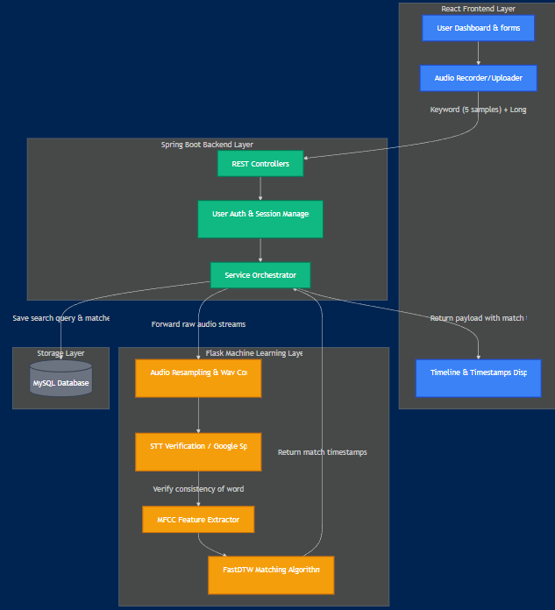
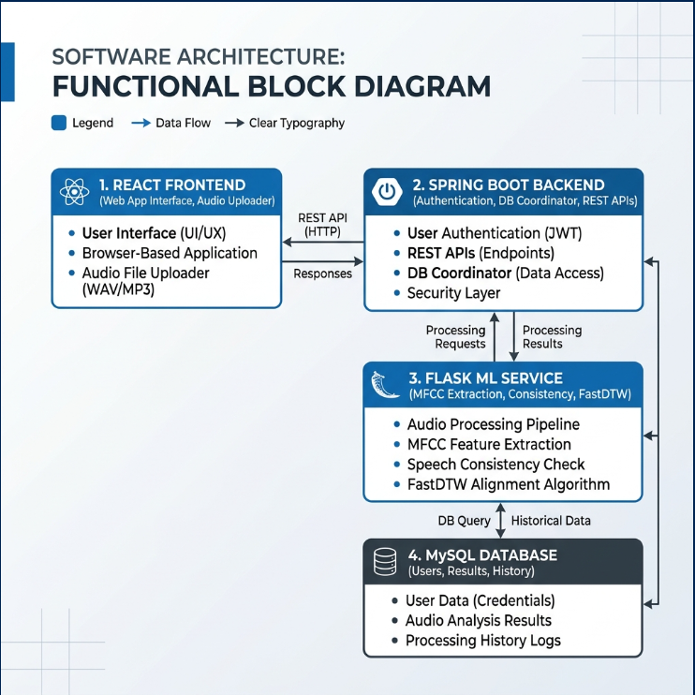
Functional Block Diagram and System Flow

Slide 11
Functional Block Diagram
Overview
This diagram illustrates the three-tier decoupled architecture of the project, dividing tasks between user interaction, business orchestrations, and heavy mathematical computation.
Key Architectural Components:
Presentation Layer (React JS):
Runs entirely in the client's browser.
Decoupled from the backend, communicating purely via asynchronous HTTP REST requests.
Business Logic Layer (Spring Boot API):
Serves as the central controller.
Handles user authentication, security, and coordinates requests between the user interface and the ML engine.
Processing Engine (Python Flask ML Service):
A specialized microservice dedicated purely to audio manipulation and sequence matching algorithms.
Storage Layer (MySQL):
A relational database that stores persistent metadata, user records, and query history, keeping them separate from the raw audio streams.

Slide 12
System Flow
Overview
This diagram traces the lifecycle of a keyword search query—from the moment a user uploads their voice samples to the display of the final timestamps.
Ingestion & Enrollment: The client records/uploads exactly 5 keyword samples and a search audio file. These are transmitted to the Spring Boot REST endpoints.
ML Preprocessing & Validation:
Audio files are resampled to a standardized 16kHz Mono WAV format via pydub.
The Google Speech API performs a transcription consistency check on the 5 samples to ensure they contain the exact same word before processing continues.
Feature Extraction & Acoustic Matching:
Raw audio is converted to Mel-Frequency Cepstral Coefficients (MFCCs) to represent its unique acoustic properties.
Fast Dynamic Time Warping (FastDTW) aligns the keyword template against the target audio to identify matches.
Persistence & Return:
The matching timestamps are saved to the MySQL Search_Result and Search_History tables.
The data is sent back to the React UI, which updates the timeline so the user can play back the matching parts of the audio.

Slide 13




Workflow
Provide a target keyword along with a few (for example, 5) audio recordings of that keyword.
Upload a longer audio recording in which the keyword should be searched.
The system extracts audio features from both the sample recordings and the target audio.
It compares learned representations to identify occurrences of the keyword.
The detected timestamps of every occurrence are returned to the user
SIMPLE WORKFLOW
+
Keyword sample
Target audio
Analyzing
Keyword spotting

Slide 14
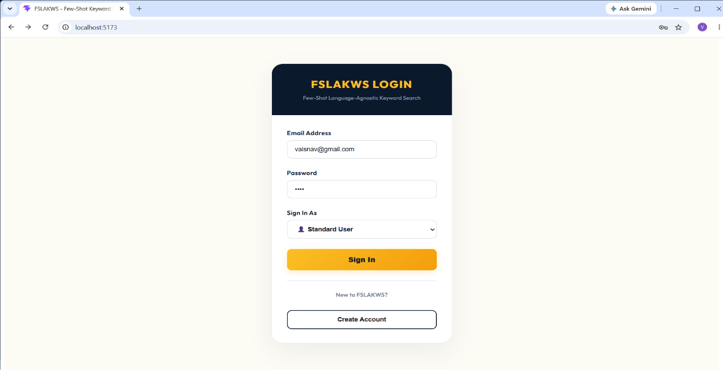
Screenshot – Login Page
Registered users can securely access the system by entering their email address and password, selecting the appropriate user role, and clicking the "Sign In" button.

Slide 15
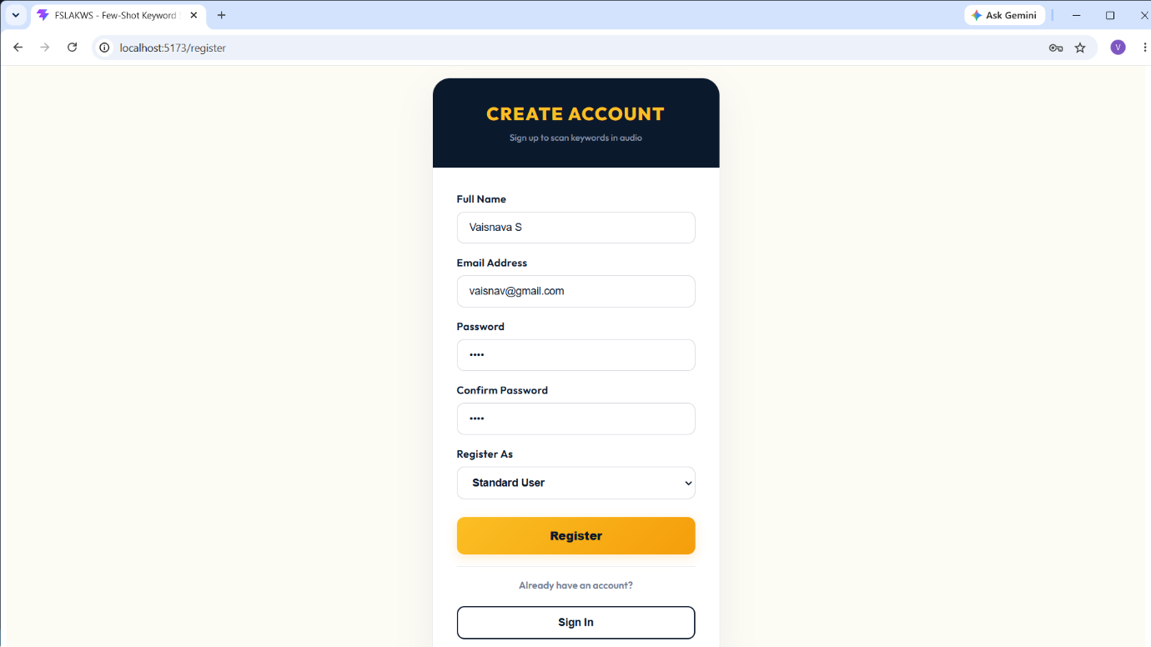
Screenshot – Registration page
New users who do not have an account can register using the "Create Account" option.

Slide 16
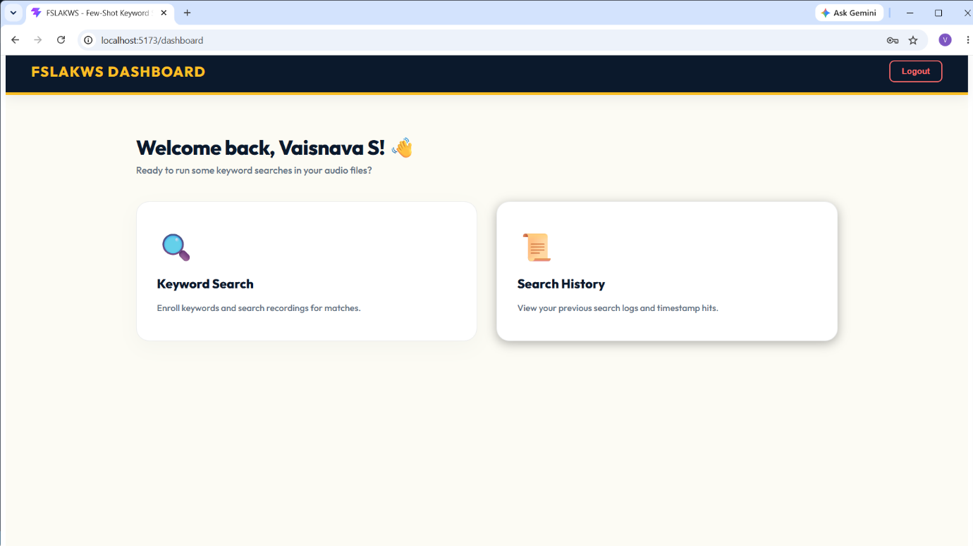
Screenshot – User Dashboard
This page enables the user to access the functionalities of the system.

Slide 17
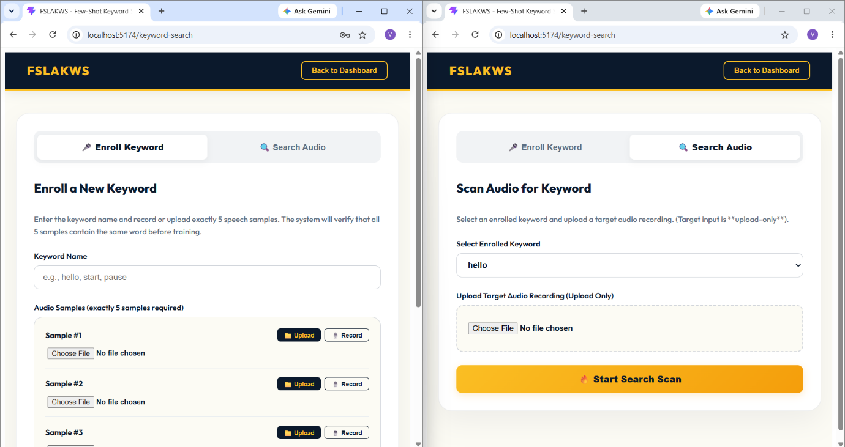
Screenshot – Keyword search pages
This enables the user to upload or record the keyword audio, upload the target audio.

Slide 18
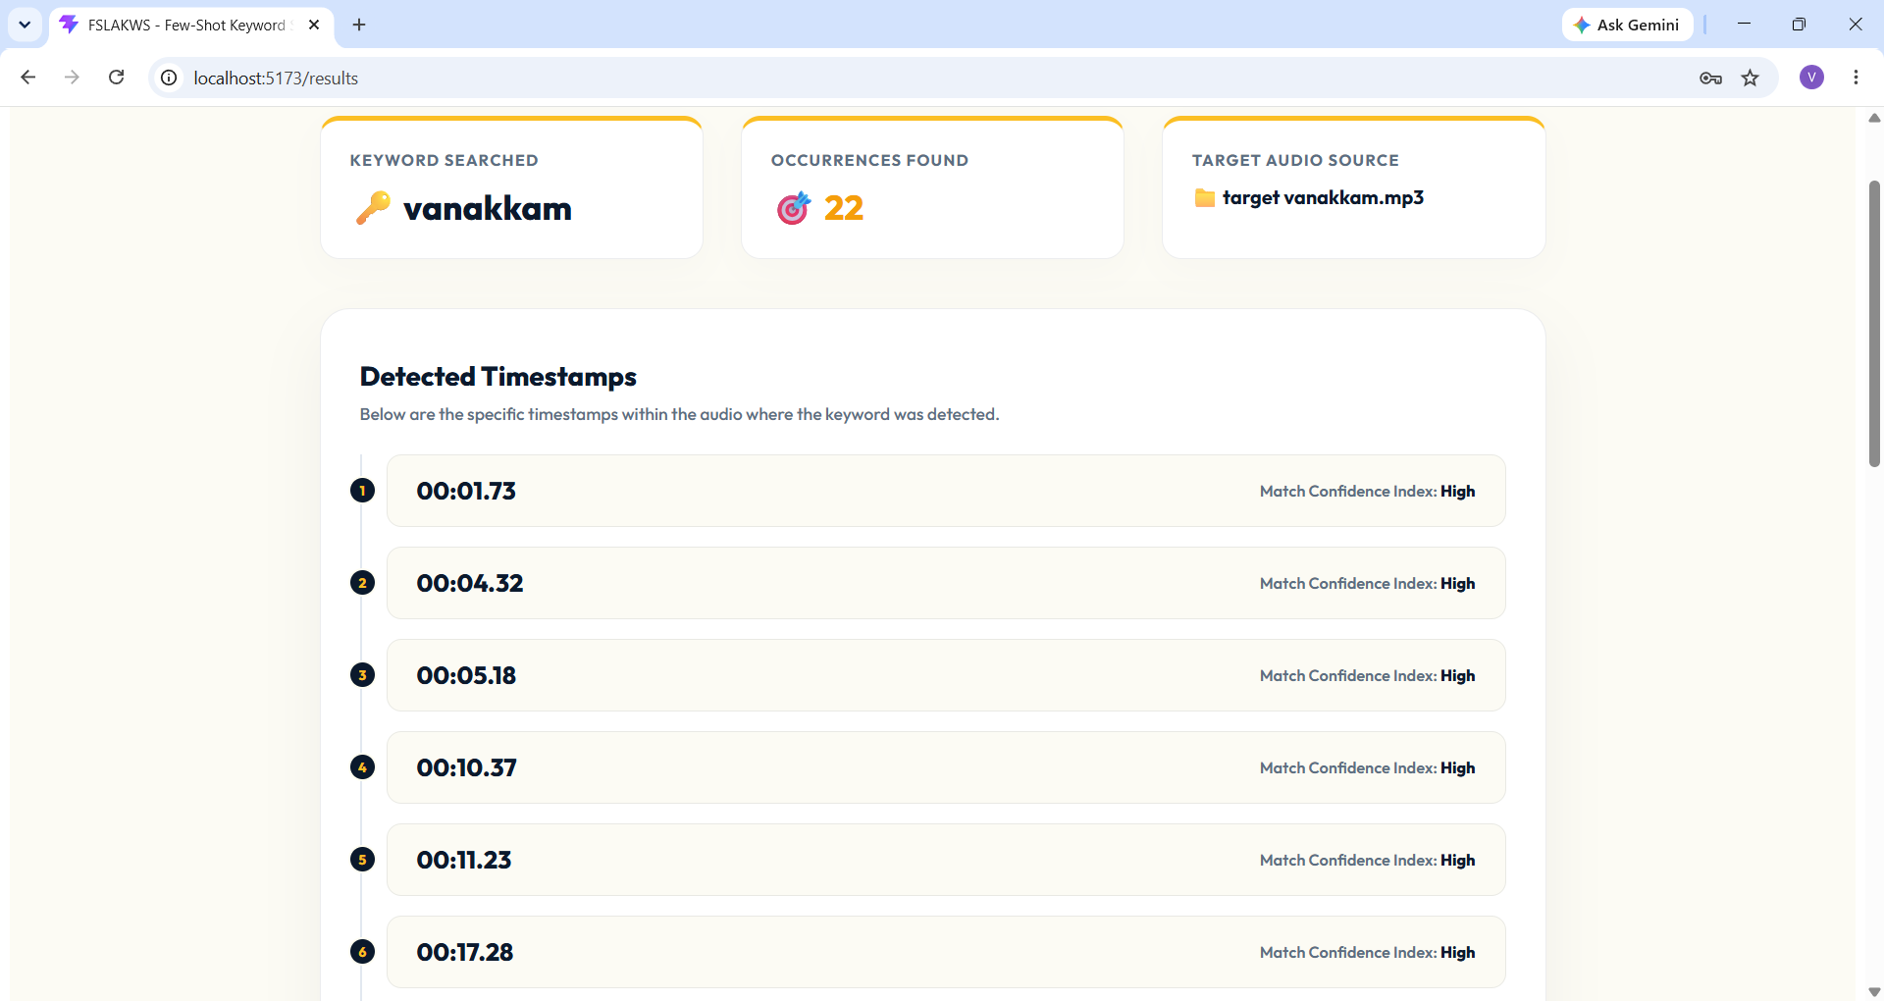
Screenshot – Keyword search result page
This presents the result of keyword search by the user.

Slide 19
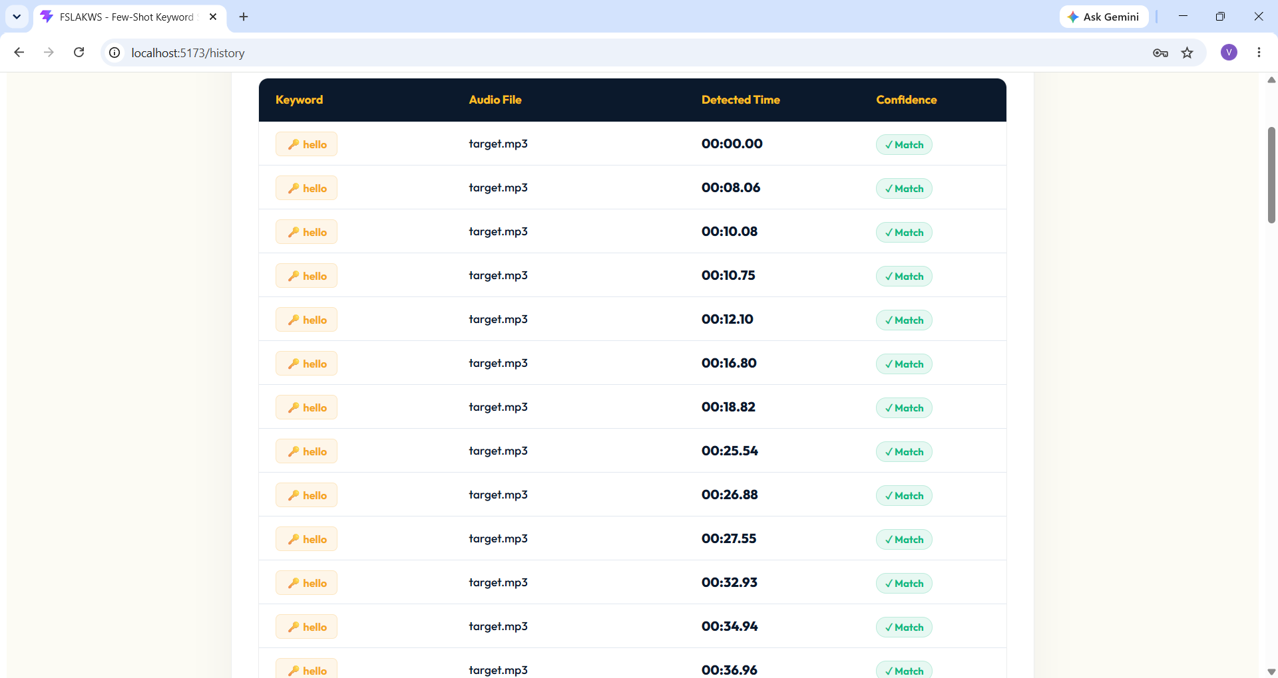
Screenshot – Search history page
This page maintains a chronological record of keyword spotting operations, allowing users to view details of previous searches, including the keyword, target audio, detection timestamps, and search date.

Slide 20
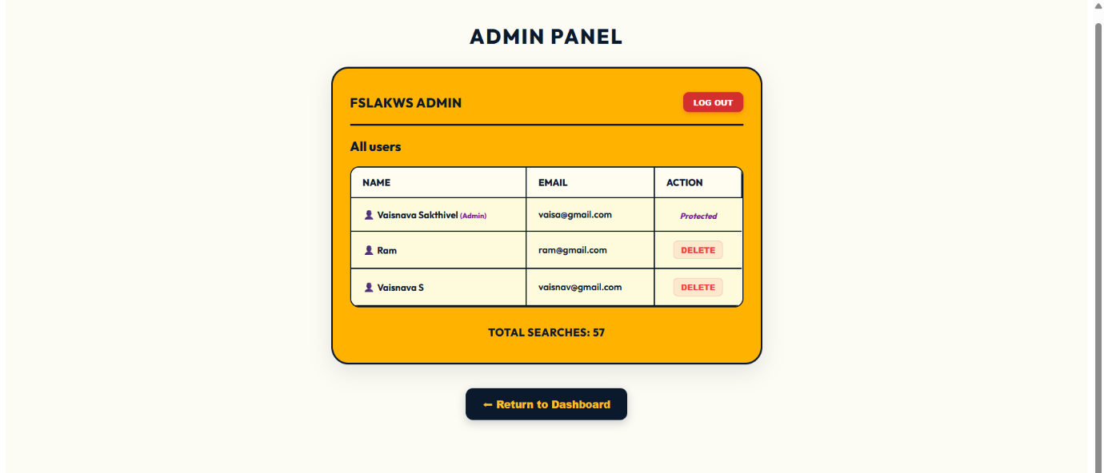
Screenshot – Admin Panel
Admin controls and maintain the actions done by the user.

Slide 21
Conclusion
In conclusion, the Few-Shot Language-Agnostic Key Word Spotting System (FSLAKWS) successfully addresses the limitations of traditional keyword spotting by providing a lightweight, training-free solution that requires just 5 audio samples to run. By merging the speed of a React interface, the reliability of a Spring Boot and MySQL backend, and the flexibility of an acoustic Python ML engine (MFCC + FastDTW), the project delivers an efficient and user-friendly platform. It breaks down language barriers and data requirements, proving to be a highly scalable and language-independent tool for automated audio search and retrieval.

Slide 22
THANKING YOU

